Slide 1


Slide 2


Project Name : Food Delivery App
Team Members :
Mahmoud Mohammed Fathi
Amir Elsayed Abdel Samie
Ahmed Yousry Mohammed
Implementing company : AST

Slide 3
Project Overview
- Comprehensive food ordering application
- User website, admin panel for order management
- Backend server for data processing and API management

Slide 4
Technologies Used
- React JS: Dynamic user interface
- Redux: State management
- Node JS and Express: Backend server
- MongoDB: Flexible database
- Stripe: Payment processing
- TailwindCSS : Responsive design

Slide 5
Project Creation Process
- Frontend Development: Reusable components
- Admin Panel: Real-time order monitoring
- Backend Development: Secure API services
- Payment Integration: Stripe for secure transactions

Slide 6
Frontend Development
Home
Place Order
My Orders
Food Single Item
Cart
Verify

Slide 7
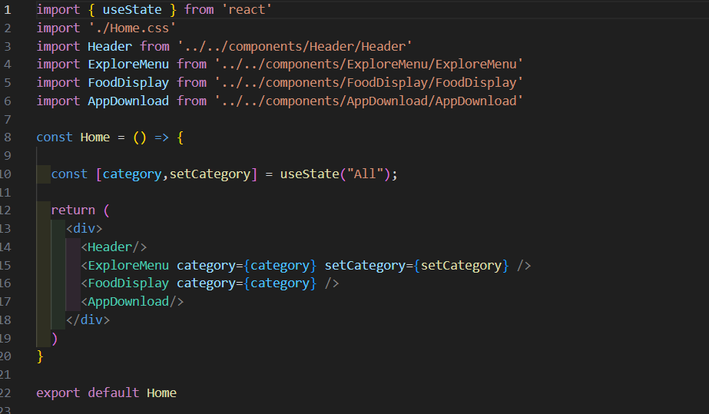
Home

Slide 8
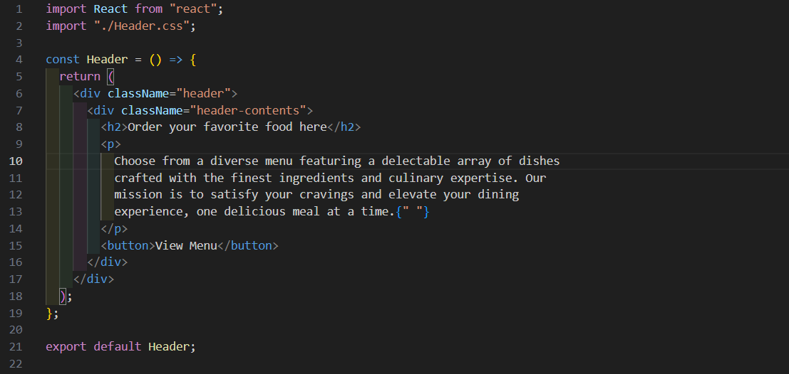
Header

Slide 9
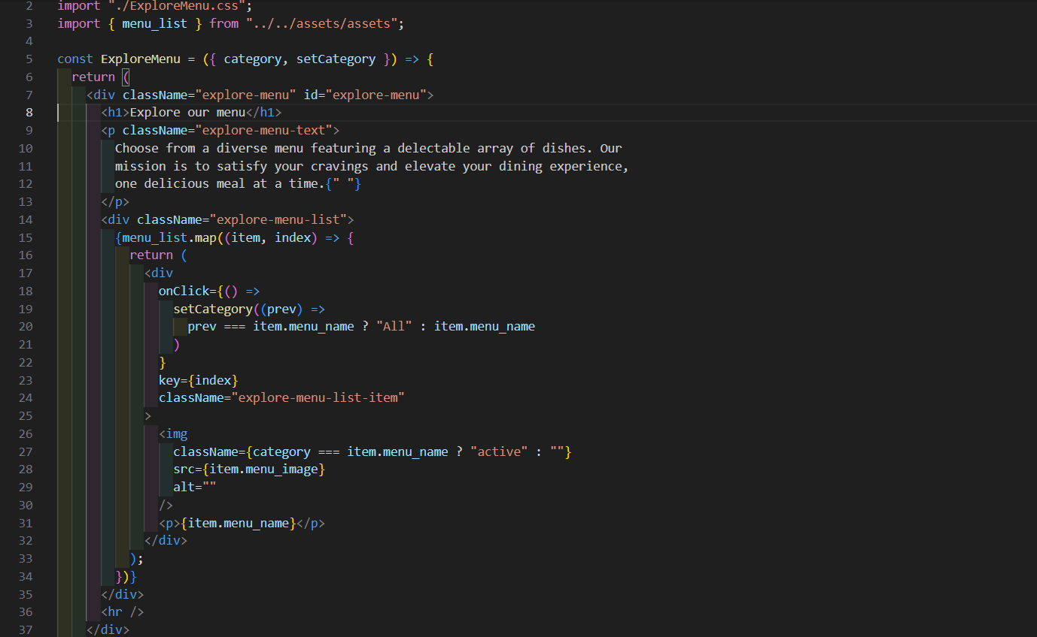
Explore Menu

Slide 10
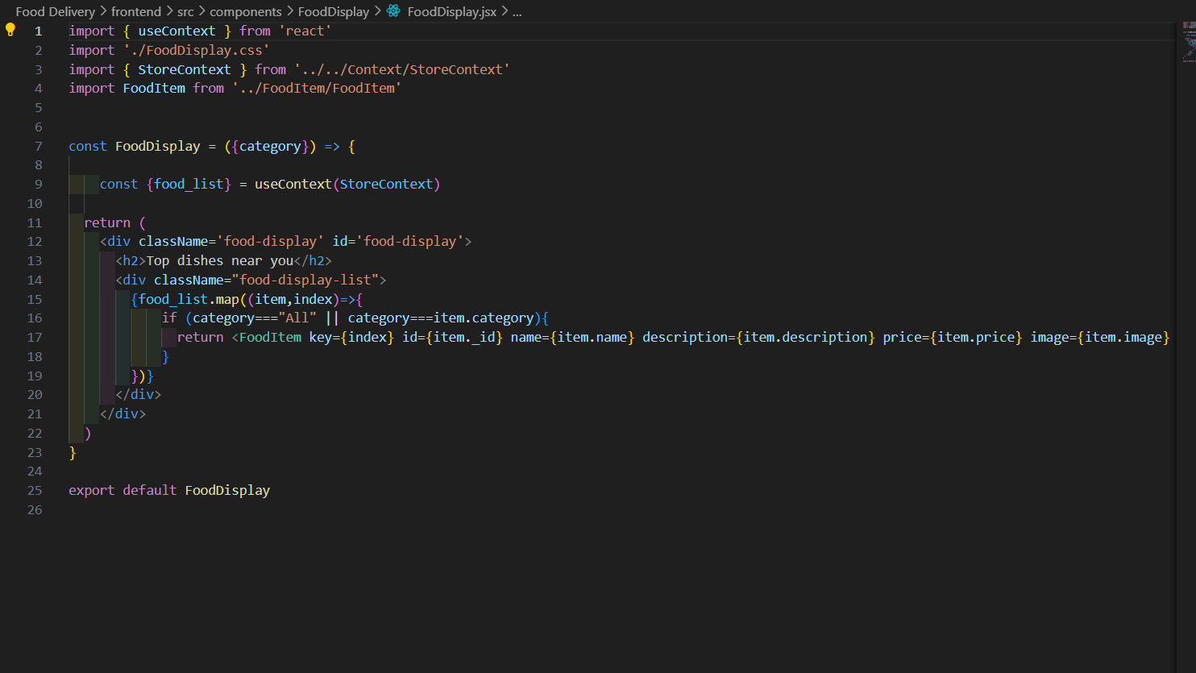
Food Display

Slide 11
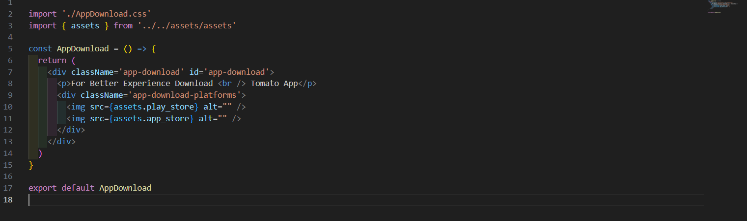
App Download

Slide 12
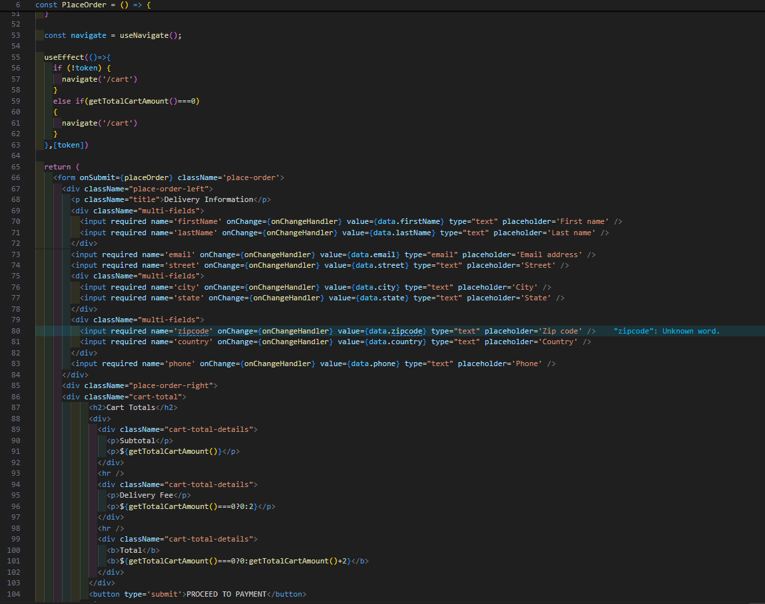
Place Order

Slide 13
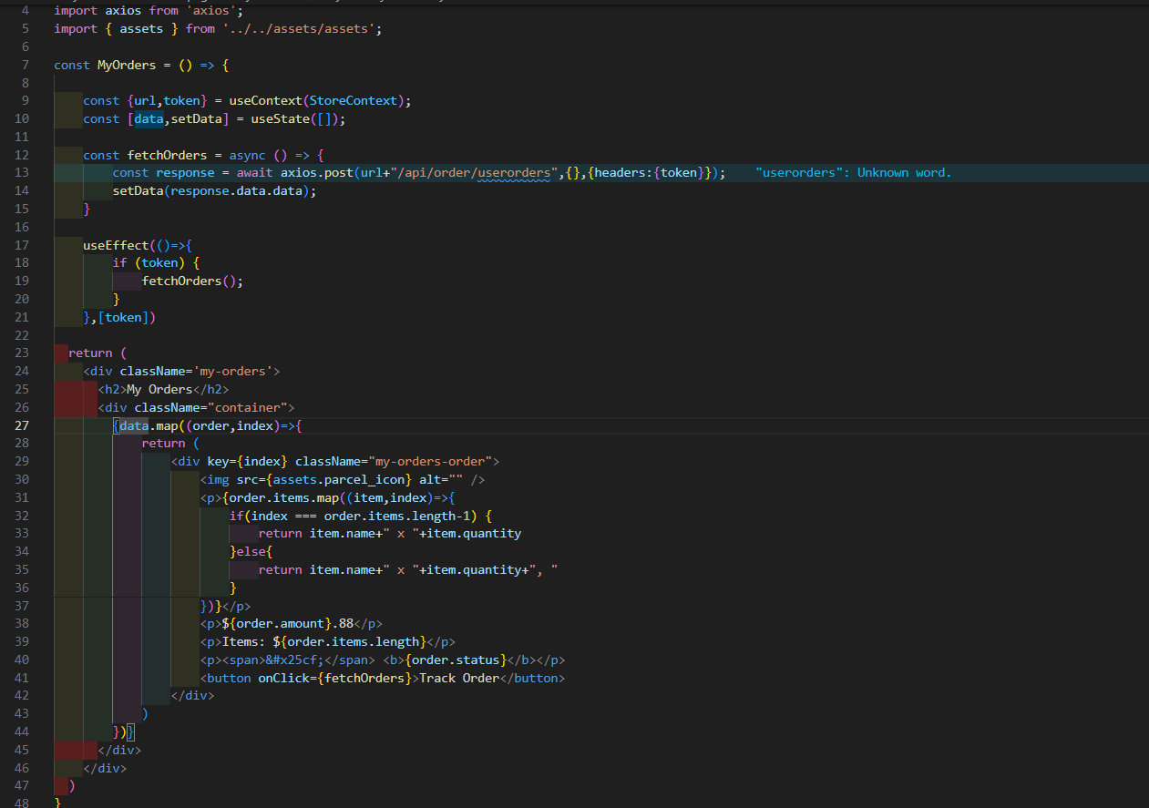
My Orders

Slide 14
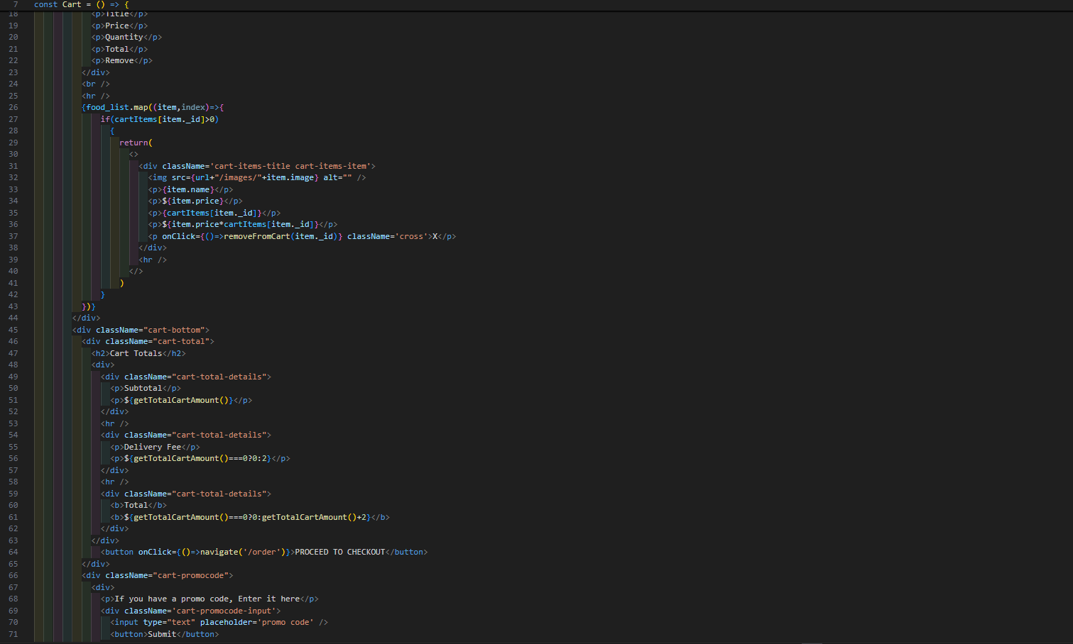
Cart

Slide 15
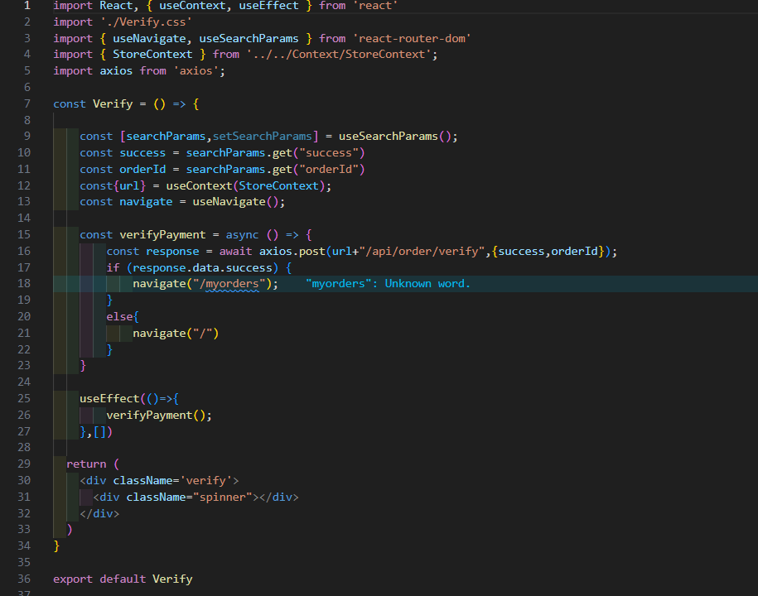
Verify

Slide 16
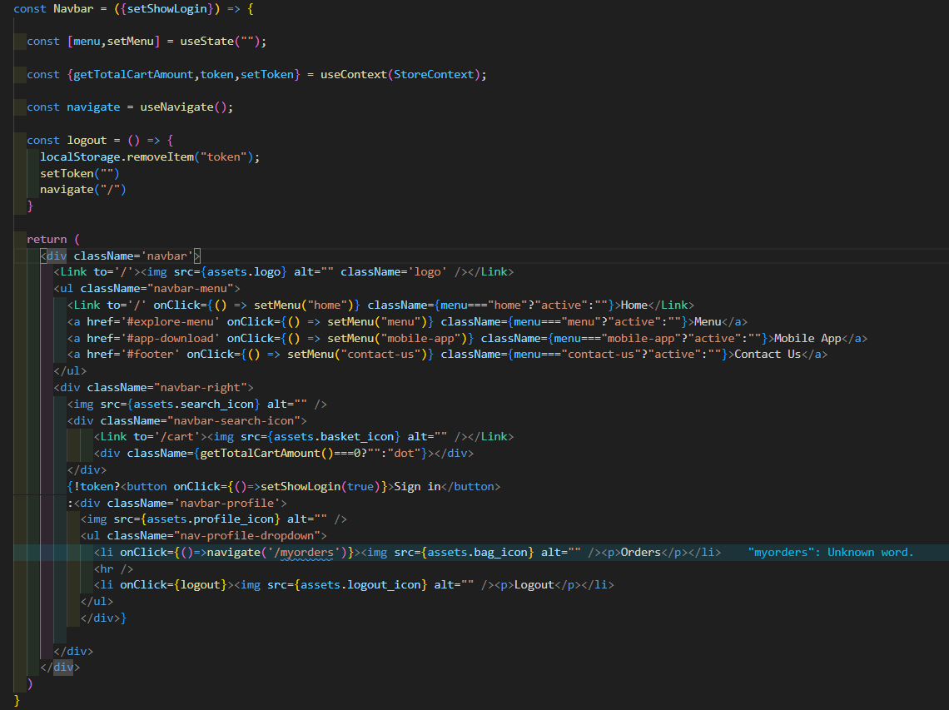
Navbar

Slide 17
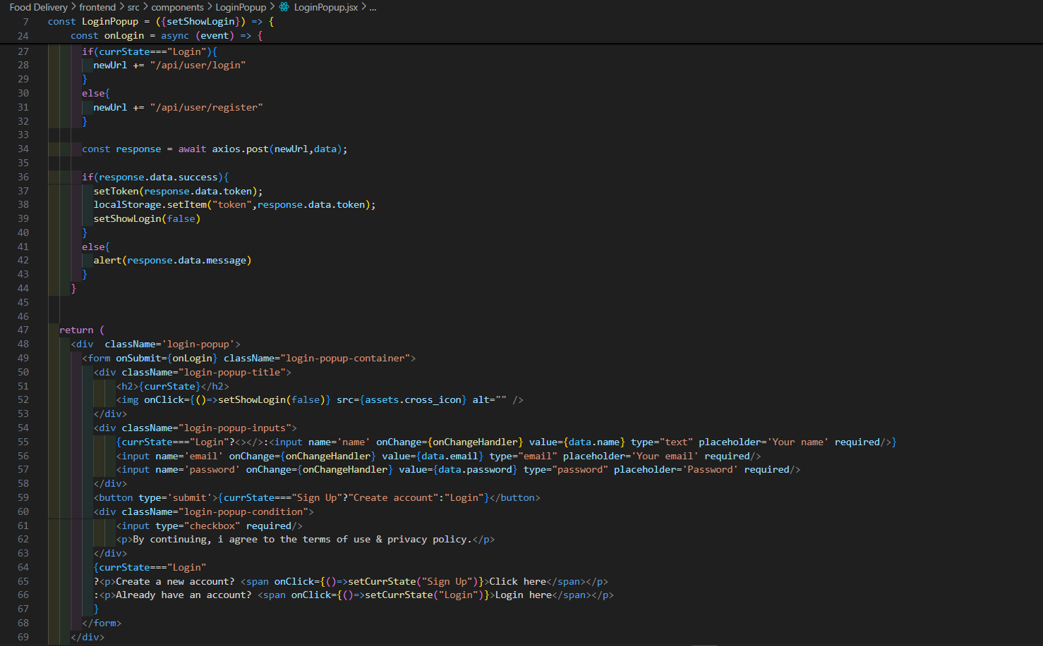
Login Pop

Slide 18
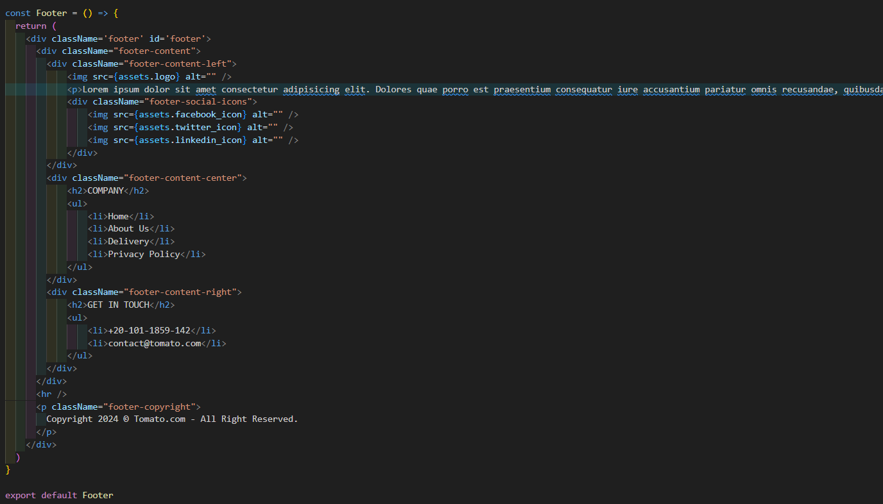
Footer

Slide 19
Admin Panel
Sidebar
Add Items
List Items
Orders

Slide 20
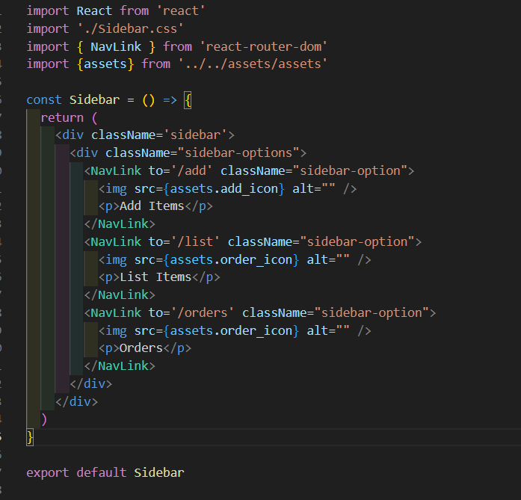
Sidebar

Slide 21
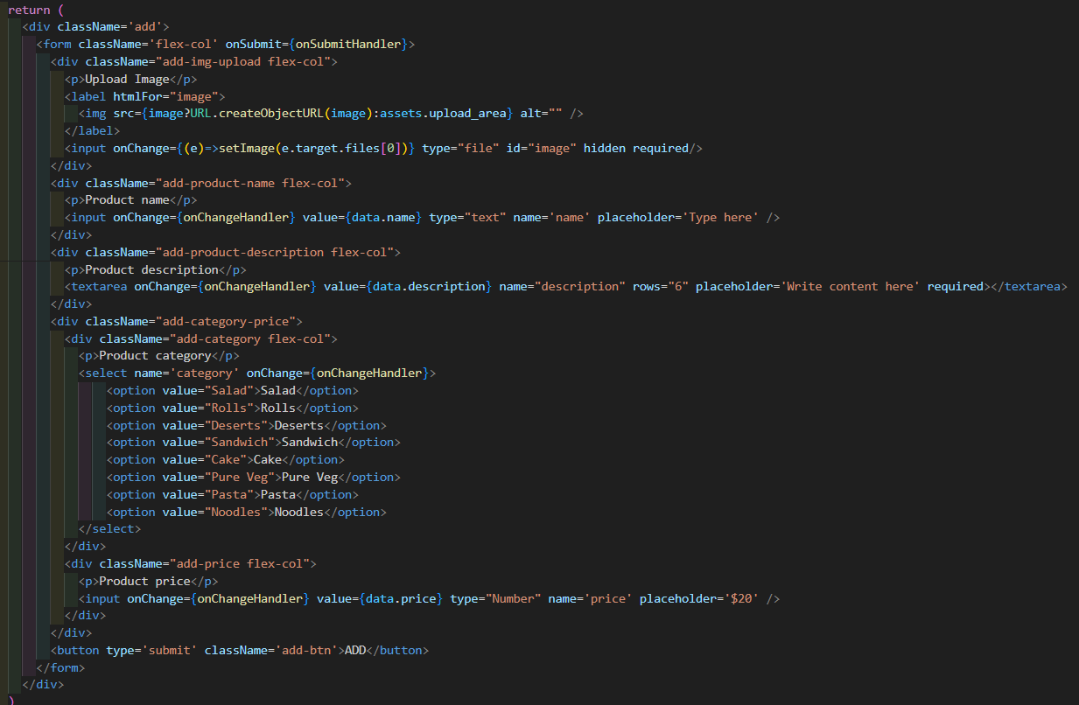
Add Items

Slide 22
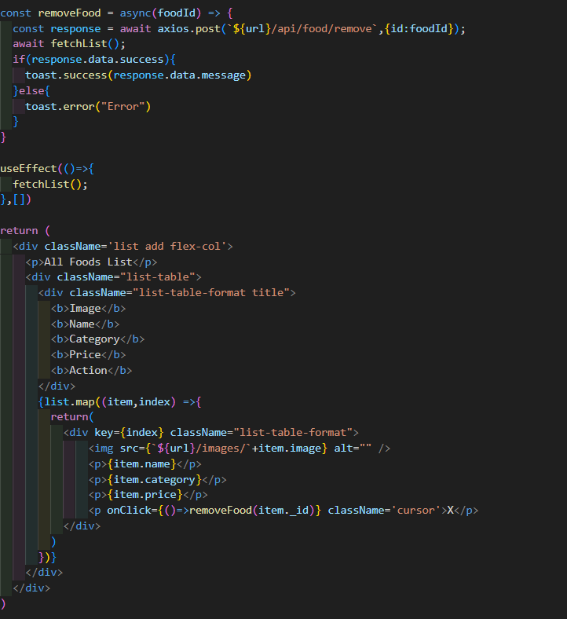
List Items

Slide 23
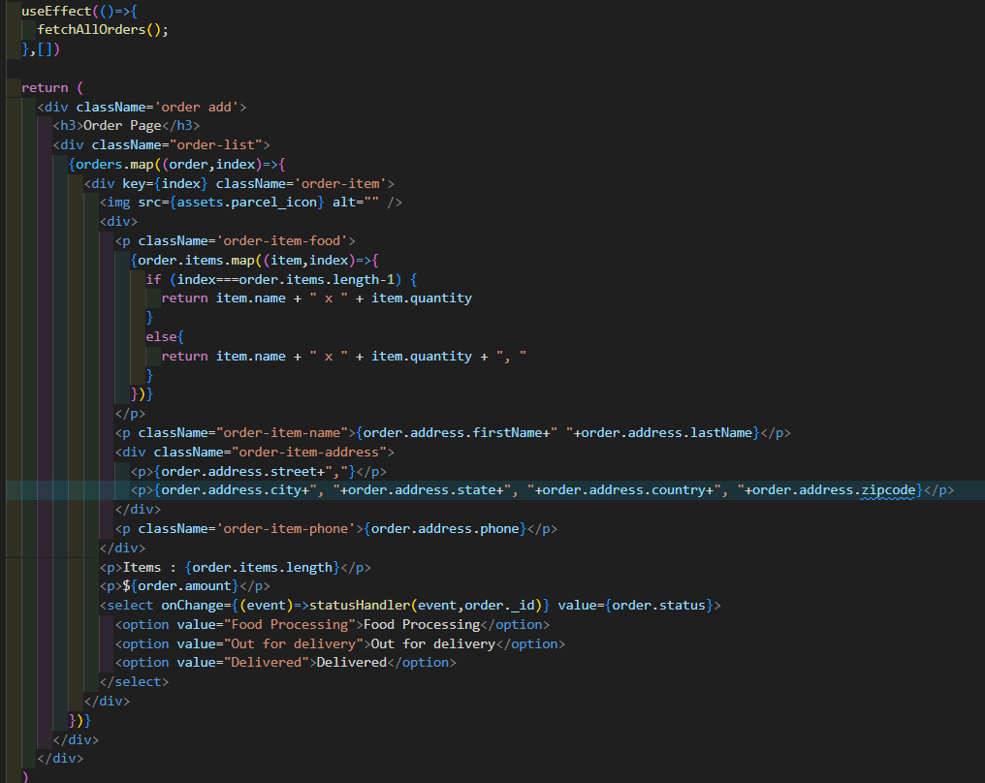
Orders

Slide 24
Backend Development
Cart Controller
Food Controller
Order Controller
User Controller

Slide 25
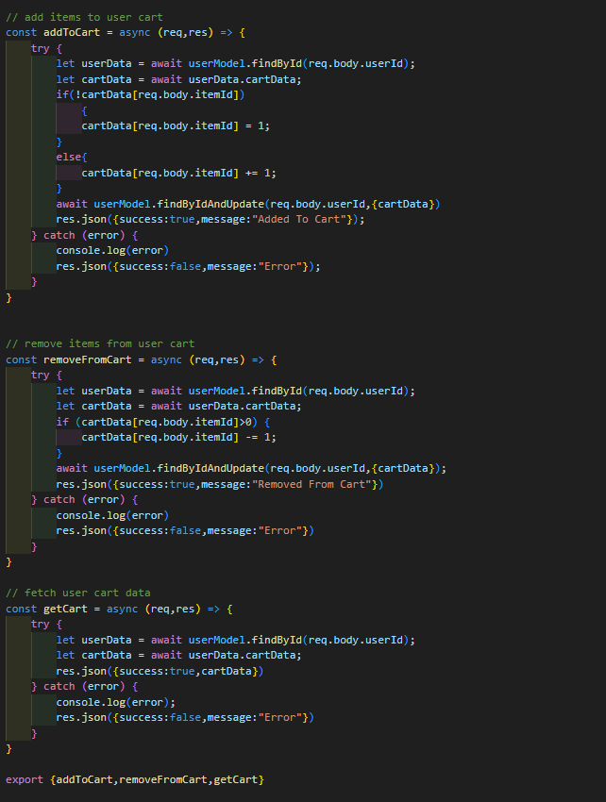
Cart Controller

Slide 26
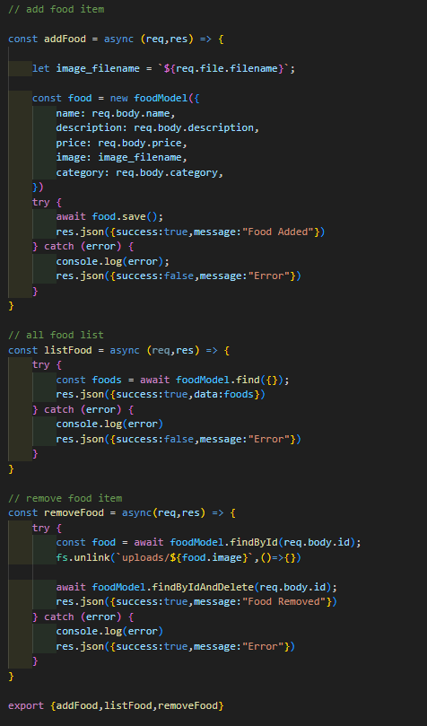
Food Controller

Slide 27
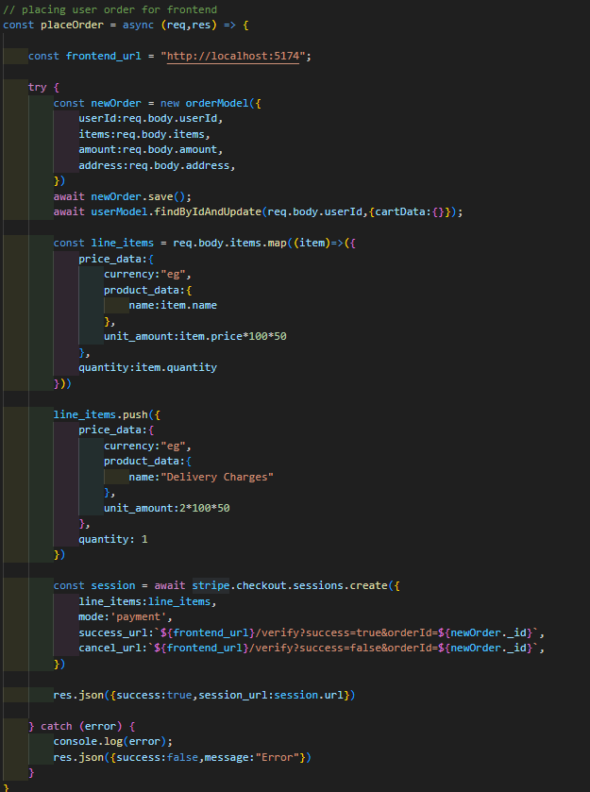
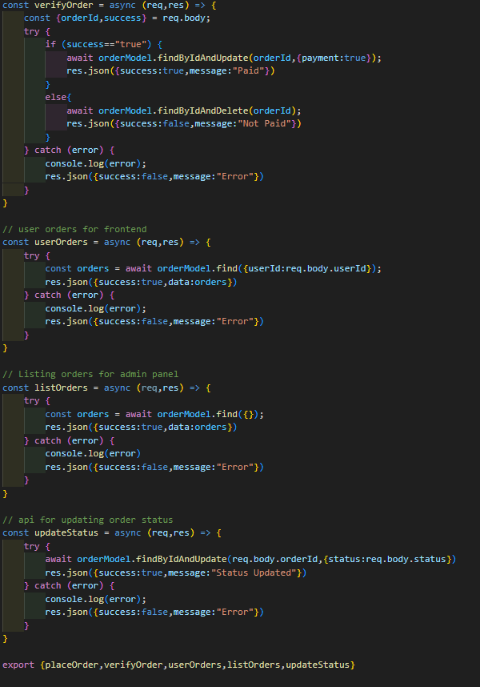
Order
Controller

Slide 28
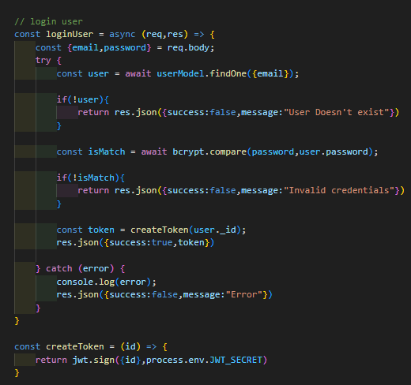
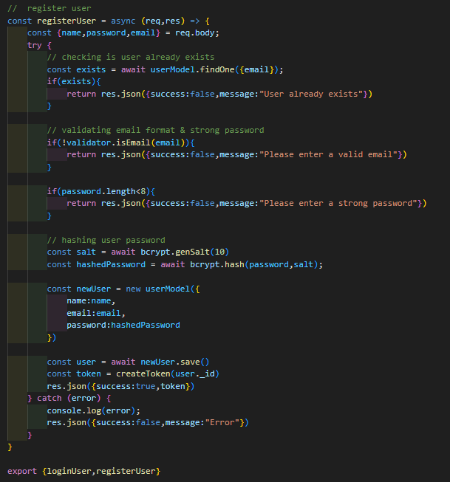
User
Controller

Slide 29
How to Run the Project
Prerequisites: Node.js, MongoDB, Stripe API
- Setup: Install dependencies, configure environment
- Running: Start backend server, launch frontend
URL:https://drive.google.com/file/d/1Xm6Sw48tvhEpviXuSKFqAU4U9_FHYce1/view?usp=drive_link

Slide 30
Thank you for your attention 😊.

